Slide 1
Existing Process
Proposed Process
Purpose to Implement RFID
Suggested HW
RFID Implementation at OMEGA Line
L&T Vadodara
Stallion Systems & Solutions Pvt Ltd

Slide 2

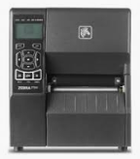


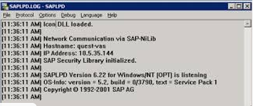
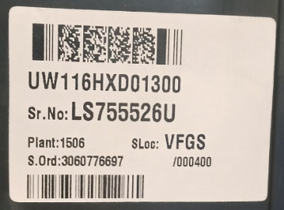
Existing Process at Barcode Printing Station Product label
Existing Process at Barcode Printing Station
SAP TCODE - ZACBLP
Front
STATION - 1
Barcode
Dimension | Length - 35mm Height - 25mm
Type | Paper Type- Polyester
Ribbon | Resin
Printer | ZEBRA ZM400,ZT230,ZT420
Software | SAP System
One person print the product label from SAP
One stage another person will scan the barcode from barcode scanner and take a print of MRP label then another person will past the same on finished material
Label should match with material and product sticker

Slide 3


Proposed Process at Barcode Printing Station (Autonomous RFID Encoding) Product label
SATO CL4NX (203dpi)
Back
SAP TCODE - ZACBLP
Front
STATION - 1
SATO CL4NX + RFID Encoder
Encoding Of “Serial Number”:
LS755526U
Back

Slide 4

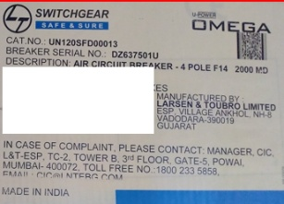
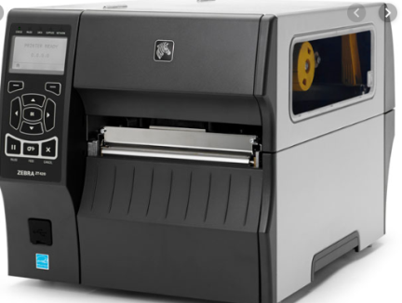

Existing Process at MRP Label Pasting
SAP T-CODE= ZACBLP
Scanning of Barcode Code
Packing STATION
ZM400,ZT230,ZT420
MRP Label
One person print the product label from SAP
One stage another person will scan the barcode from barcode scanner and take a print of MRP label then another person will past the same on finished material
Label should match with material and product sticker

Slide 5


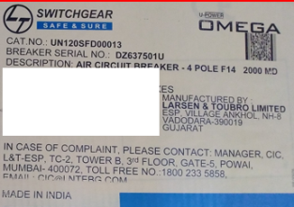
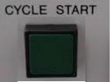
Proposed Process at MRP Label Pasting with RFID label and scanning
SATO CL4NX (203dpi)
SAP T-CODE= ZACBLP
Packing STATION
SATO CL4NX
MRP Label
RFID Reader + Antenna

Slide 6
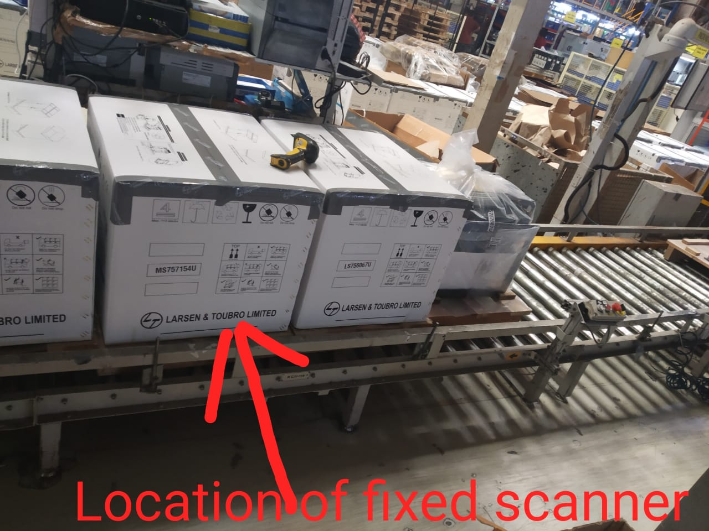
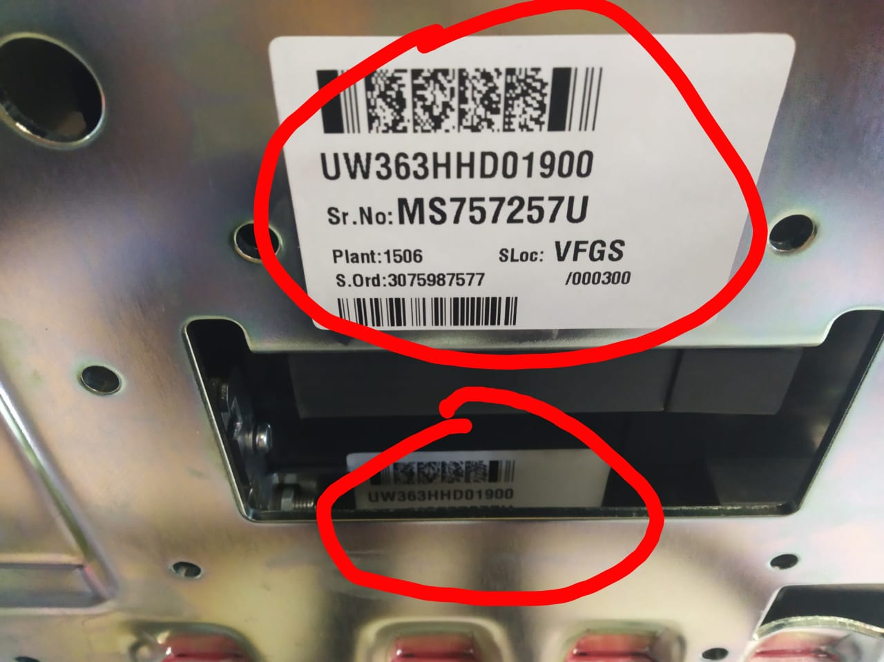

Slide 7
Purpose to Implement RFID :
Need to verify product barcode and MRP barcode should match
For this we will past RFID tag inside box on the product which we can consider product barcode
Then on the product box another RFID tag we will past which we can consider as a MRP barcode
After one stage we will scan through RFID reader that tag data comes in software and verify the product is ok or not.
This way they could verify make sure the actual product
Suggested HW :
Alien F800 + POE
Antenna
ALR H450
RFID paper tags

Slide 8
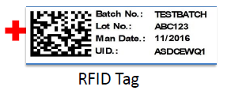

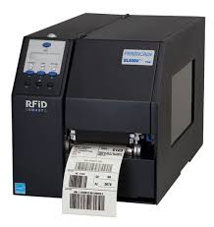
Suggested HW :
Alien F800
Antenna
ALR H450
RFID paper tags
Alien ALR-F800 Reader
ALR-H450
RFID Paper Tag
STA AN86609C
RFID Printer

Slide 9

Thank You

